Slide 1

NP-complete
Prof. Zhenyu He
Harbin Institute of Technology, Shenzhen
2023/9/4

Slide 2

Outline
1. The complexity of the problem
2. P-problem and NP-problem
3. NP-hard problem and NPC problem
4. Common resolution strategies for NPC problem

Slide 3
1. The complexity of the problem
1.1 The introduction
1.2 Polynomial time
1.3 Decision-making and optimization issues

Slide 4
1.1 The introduction
Faced with a problem, we first consider whether it can be solved with existing algorithms. Second, consider whether the existing algorithm is fast enough。
An algorithm with time complexity is O (n⁴), which is completely acceptable. Because it can still get results in a reasonable amount of time with a very large input.
So how do we define the complexity of the problem?

Slide 5
1.2 Polynomial time
We use polynomial time limits to define how easy a problem is.
When we determine whether a question can find an algorithm for polynomial time limits, there are three cases:
Yes (just find it) No(prove)
All algorithms that prove the problem are exponentially timed. Algorithms that prove that there is no polynomial time limit exist to solve the problem.
Not sure(Not found at the moment, doesn't mean no, that's the next NPC problem)

Slide 6
1.2 Polynomial time
Traveling Salesman Problem(TSP)：
Find a shortest path through all towns and back to the origin, 1→2 →3 (1→3→2) →. . . The distance between the two paths is not the same. Possible routes are: n!
A simple idea is to traverse all paths and need O(n!) time. The time complexity is O (2^{n}) and the dynamic planning time complexity is O(2^{n}∗n²). The incestation of an algorithm in polynomial time is a "difficult problem" for a computer.

Slide 7
1.2 Polynomial time
A problem can be solved in a polynomial time, saying it is easy to solve.
A problem cannot be solved in polynomial time, saying that the problem is not easy to solve.

Slide 8
1.3 Decision-making and optimization issues
Decision question: A computational problem with the expected output of Yes or No, 1 or 0 Optimization problem: We try to construct a solution to maximize or minimize the computational problem of certain values
Example(TSP)：
Optimization problem: Given a band map, find a shortest path through all points and back to the origin. Determine the problem: Given a weight chart and a number of k, whether there is a path through all points and back to the origin with a total weight less than or equal to k.

Slide 9

P-problem and NP problems
2023/9/4

Slide 10
2 P-problem and NP problems
2.1 P-problem
2.2 NP-problem
2.3 P-problem & NP-problems
2.4 The meaning of P=NP

Slide 11
2.1 P-problem
Question：
Find the median of the sequence{3,1,2,4,7} (number of n/2 positions after sorting) Determine whether k-3 is the median of the above sequence (thinking)
Obviously, an algorithm can be found to solve the above problems in polynomials.

Slide 12
2.1 P-problem
Definition of a P problem: A problem that can be solved in polynomial time is called a P-problem
What are the other P questions?
Find the maximum value of the sequence of {3, 1, 2, 4, 7 } Determines whether k=4 is the maximum value of the above sequence

Slide 13
2.2 NP-problem
Question: Do mass factor decomposition of 41607317.
Thinking: If you give a possible answer of 8699 and 4783, can you verify that these two numbers are correct in a polynomial time?

Slide 14
2.2 NP-problem: 3-SAT
Question：Bool collection (x₁, x₂, x₃, x₄, x₅), whether there is a set of assignments (x₁ || x₂ || x₃)&&(x₁ || !x₂ || !x₃)&&(!x₁ || x₄ || x₅)==true？ (3-SAT problem)
Thinking：
How to solve the above problems?(2⁵)
If there is given a set of solutions to x_{i}={0, 1,1,0,1}, is there an algorithm to verify the correctness of the solution in polynomial time? Whether there is an algorithm to solve the above problem in polynomial time? (Not found so far)
x₁ | x₂ | x₃ | x₄ | x₅
0 | 0 | 0 | 0 | 0
0 | 0 | 0 | 0 | 1
… | … | … | … | …

Slide 15
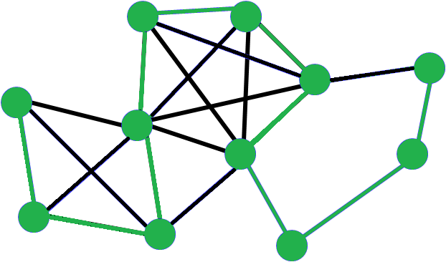
2.2 NP-problem：Hamilton circuit problem
Hamilton circuit problem：Given the directionless graph G(V, E), determine whether it passes through the loop of each vertex in the graph only once.

Slide 16
2.2 NP-problem
Definition of an NP problem: A problem that can be validated in polynomial time.
Thinking：
Is the median NP problem? (We already know it's a P problem) Is the 3-SAT problem an NP-problem and a P-problem?

Slide 17
2.3 P-problem & NP-problem
Obviously all P-problems must be NP-problems
It can be solved in polynomial time, then it must be verifiable in polynomial time
NP
P

Slide 18
2.3 P-problem & NP-problem
So are all NP-problem P-problems?
The median is an NP-problem, and it is also a P-problem 3-SAT is an NP-problem, is it a P-problem?
There is currently no evidence that P=NP ,which is still an open question.

Slide 19
2.4 The meaning of N=NP
If NP is verified, a problem can be solved in polynomial time, and an algorithm can be found to solve the problem in polynomial time. Computers become more "smart" and can quickly find a shortcut to a very chaotic situation.

Slide 20
2.4 The meaning of N=NP
1. Many of the challenges in operational planning will be easily solved, such as integer planning, traveling salesman , and so on. 2. When all the information is available, the computer can make very accurate predictions about the stock market, weather, and the results of the game in a very short period of time. 3. The issue of protein folding is also a NPC problem, and the new algorithm is undoubtedly a boon for the biological and medical community. ......

Slide 21
NP-hard & NPC
2023/9/4

Slide 22
3 NP-hard & NPC
3.1 Polynomial time reduction
3.2 NP-hard & NPC
3.3 The distinguish of P, NP, NP-H, NP-C
3.4 The meaning of NPC problem

Slide 23
3.1 Polynomial time reduction
Question A: Solve a unitary equation at once Question B: Solve a one-dimensional secondary equation
Reduce
$$ax + b = c$$
$$0x^{2} + ax + b = c$$
If there is an algorithm that can effectively solve problem B, it can also be used as a sub-program to solve problem A, we call problem A “reduce" to problem B. If I could turn an instance of problem A into an instance of problem B and then indirectly solve problem A by solving problem B, then I think B is more difficult than A.

Slide 24
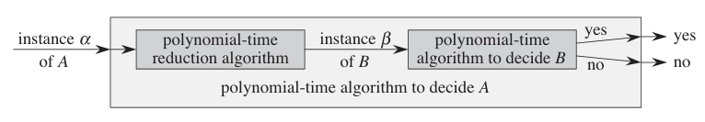
3.1 Polynomial time reduction
Consider a determination question A and hope to resolve the issue in a polynomial time, while there is a different determination question B, and we know how to resolve it in polynomial time. Finally, suppose there is a process that converts any instance α A into an instance of B that has the following characteristics β: The conversion operation takes polynomial time
The solution for both instances is the same. That is, the solution α is "Yes" and the solution that is only β is "Yes".
We call this process a polynomial time contracting algorithm. We can solve any example of problem A, as shown in the following figure:

Slide 25
3.1 Polynomial time reduction
Hamilton circuit problem：Given the directionless graph G(V, E), determine whether it passes through the loop of each vertex in the graph only once. Traveling Salesman Problem：Find a shortest path through all towns and back to the origin, 1→2 →3 (1→3→2) →. . . The distance between the two paths is not the same.
Thinking: How do you put the HSP problem down to a traveler's problem?

Slide 26
3.1 Polynomial time reduction
Hamilton Circuit Problem can be reduced to Travelling Salesman Problem：
In the Hamilton Circuit Problem, we assume that two points are connected, i.e. the distance between the two points is 0, and the distance between the two points is not directly connected to 1, so the problem translates into whether there is a path with a length of 0 in the TSP problem. Hamilton loops exist when and only if there is a loop with a length of 0 in the TSP problem.

Slide 27
3.1 Polynomial time reduction
By making a contract on some problems, we can find algorithms with high complexity but wide application to replace algorithms with low complexity but can only be applied to a very small class.

Slide 28
3.2 NP-hard & NPC
NP-hard：All NP problems can be attributed to question D within the polynomial time complexity, and then the D problem becomes the NP-hard problem.
NPC（NP-completeness）：All NP problems can be attributed to NP problem D within polynomial time complexity, then NP problem D becomes NPC problem.
NPC Question D should satisfy the following two things:
The problem D is NP-hard The problem D belong to NP-problem

Slide 29
3.2 NP-hard &NPC
As a general saying, a problem can be verified in polynomial time, but no polynomial time algorithm has been found to solve this problem, we call this kind of problem NPC problem.
The first proven NPC problem : 3-SAT problem The Hamilton Circuit Problem is also an NPC problem. Prove that an NP-problem D is an NPC problem, just reduce a known NPC problem to question D in polynomial time, then D is also an NPC problem.

Slide 30
3.2 NP-hard & NPC
Please prove that TSP is an NPC issue (HSP is known to be an NPC issue).
Construct the reduction function T：Given a unweighted graph G and weighted complete graph G’ which has same vertex. If there are an edge between any two nodes in G, the weight of the edge between the two corresponding nodes in G’ is zero, otherwise it is 1. Then make K=0.
The reduction function T can be implemented in polynomial time. The TSP problem itself is an NP problem.
So the TSP problem is also an NPC problem.

Slide 31
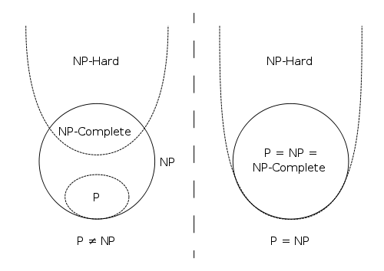
3.3 The distinguish of P, NP, NP-H, NP-C

Slide 32
3.4 The meaning of NPC problem
Why we take out the hardest questions in the NP? （NPC）

Slide 33
Common resolution strategies
for NPC issues
2023/9/4

Slide 34
4 Common resolution strategies
4.1 Exponential algorithm
4.2 Approximate algorithm

Slide 35
4.1 Exponential algorithm
The exponential algorithms commonly used to solve NPC problems are:
Dynamic planning Branch boundary method Backtracking

Slide 36
The concept of backtracking
The backtracking algorithm is actually an enumerated search attempt, mainly in the search attempt to find the solution to the problem, when found that the solve conditions have not been met, "backtrack" back to try other paths.
Many complex and large-scale problems can use the backtracking method, which has the reputation of "universal problem-solving method".

Slide 37
The basic idea of backtracking
In the solution space tree that contains all the solutions to the problem, the solution space tree is explored in depth from the root node according to the strategy of depth-first search. When exploring a node, first determine whether the node contains a solution to the problem, and if so, continue to explore from that node, and if the node does not contain a solution to the problem, then backtrack to its ancestors layer by layer. (In fact, backtracking is a depth-first search algorithm for implicit diagrams.)

Slide 38
The basic steps of backtracking
Determine the space for solving the problem：The solution space for the problem should contain at least one optimal solution to the problem.
Determines the extended search rules for nodes Search for solution space in depth-first manner and use pruning functions to avoid invalid searches during the search.

Slide 39
Examples of backtracking — 0-1 backpack problem
There are N items and a backpack with a capacity of V. The volume of the i-th item is w[i], and the value is c[i]. Find out which items are loaded into the backpack so that the total cost of these items does not exceed the capacity of the backpack, and the total value is the largest. This is the most basic knapsack problem, in general: to choose or not to choose, this is a question
Let f[i][v] denote the maximum value that the first i items(前i个商品) can get in a backpack with a capacity of v.
For an item, there are only two cases
Case one: The i-th item is not put in, and the value obtained is: f[i-1][v]+0 Case two: The i-th item is put in, and the value is：f[i-1][v-c[i]]+w[i]

Slide 40
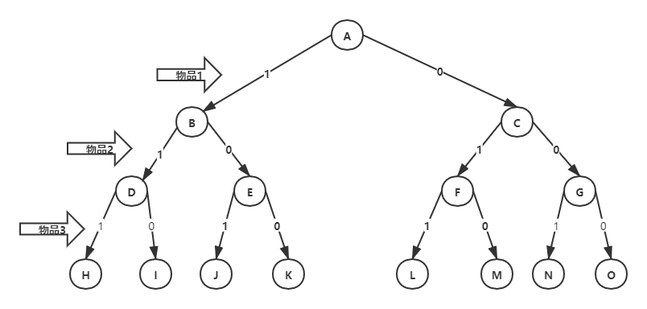
Examples of backtracking — 0-1 backpack problem
When solving a problem with backtracking, the solution space of the problem should be clearly defined. The solution space for the problem contains at least one optimal solution to the problem. For the 0/1 backpack problem at n=3, a complete binary tree can be used to represent the solution space, as shown in the figure:

Slide 41
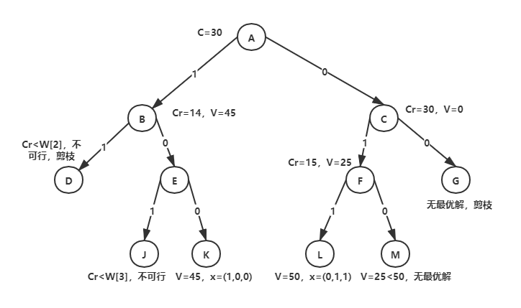
Examples of backtracking — 0-1 backpack problem
Assume that n=3, C=30(maximum capacity), w={16, 15, 15}, v={45, 25, 25}
Only 4 paths are finally searched, which is reduced by half compared to the original 8 paths in the solution space. It has been optimized to a certain extent, but its complexity is still O(2^{n}).

Slide 42
4.2 Approximate algorithm
Approximate the design idea of the algorithm
Replace the optimal solution with the approximate optimal solution in exchange for：
Simplification of algorithm design Reduced time complexity
Approximate algorithms are feasible:
The input data for the problem is approximate The solution to the problem allows for a degree of error The approximation algorithm can get an approximate solution to the problem in a relatively short period of time

Slide 43
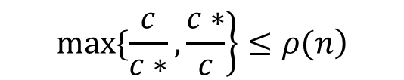
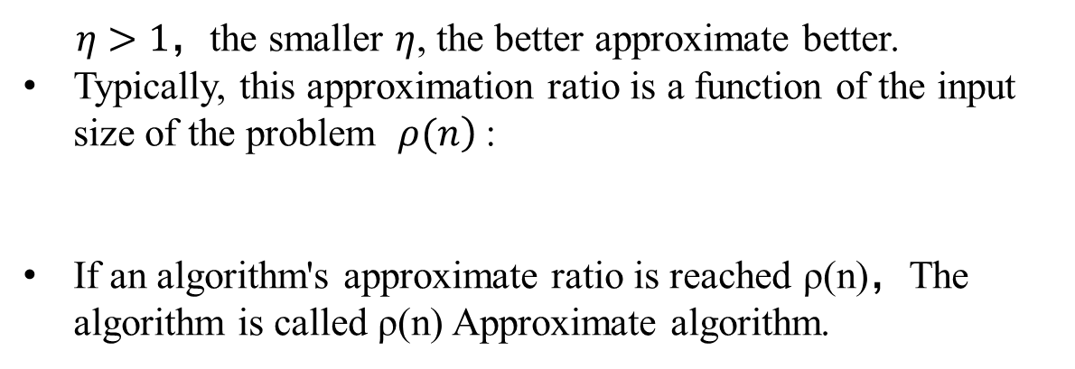
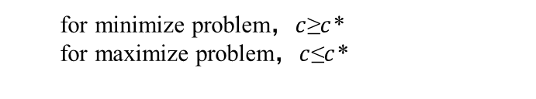
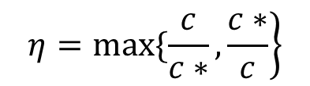
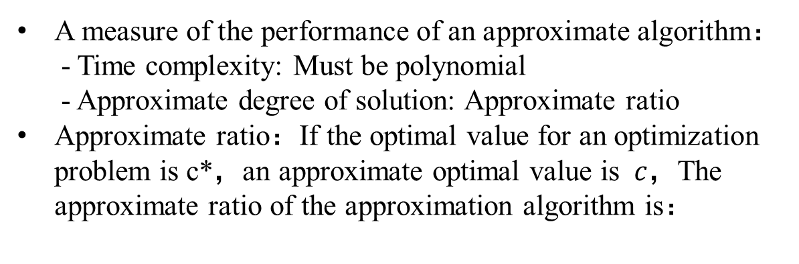
Design ideas and Performance of Approximate algorithm
A measure of the performance of an approximate algorithm：
- Time complexity: Must be polynomial - Approximate degree of solution: Approximate ratio
Approximate ratio：If the optimal value for an optimization problem is c*，an approximate optimal value is $c$，The approximate ratio of the approximation algorithm is：
$$\left.η=max\{\frac{c}{c∗},\frac{c∗}{c}\right\}$$
for minimize problem，$c$≥$c$*
for maximize problem，$c$≤$c$*
$η>1，$the smaller $η$, the better approximate better.
Typically, this approximation ratio is a function of the input size of the problem $\left.ρ(n\right)$:
If an algorithm's approximate ratio is reached ρ(n)，The algorithm is called ρ(n) Approximate algorithm.
$$\left.max\{\frac{c}{c∗},\frac{c∗}{c}\right\}≤\left.ρ(n\right)$$

Slide 44
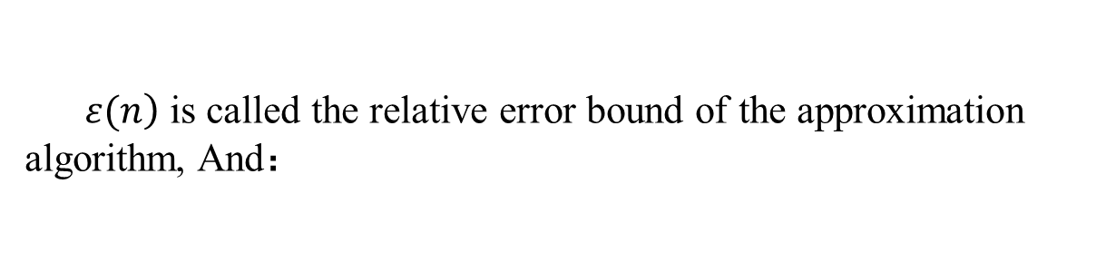
Approximate the performance of the algorithm
Approximate the relative error of the algorithm λ：
- λ denote the degree to which an approximate optimal solution differs from an optimal solution
If the input size of the problem is n，and exist a function ε(n) where：
$\left.ε(n\right)$ is called the relative error bound of the approximation algorithm, And：

Slide 45
Examples of approximate algorithms ——vertex coverage
Question：The vertex cover of the undirected graph G=(V,E) is a subset V'⊆V of its vertex set V, so that if (u,v) is an edge of G, then v∈V' or u∈V '. The size of the vertex cover V'is the number of vertices it contains |V'|.
Vertex cover problem: find the smallest vertex cover
What is the time complexity of the algorithm? O(V+E)
Cset is used to store the vertices in the vertex cover. Initially empty, continue to select one side (u, v) from the edge set E1, add the end points of the edge to Cset, and delete the edges covered by u and v in E1 until Cset has covered all edges. That is, E1 is empty.
VertexSet ApproxVertexCover ( Graph G )
{ Cset=∅；
E1=E；
while (E1 != ∅) {
Take any edge e=(u,v) from E1 ；
Cset=Cset∪{u,v}；
Delete all edges associated with u and v from E1；
}
return Cset
}

Slide 46
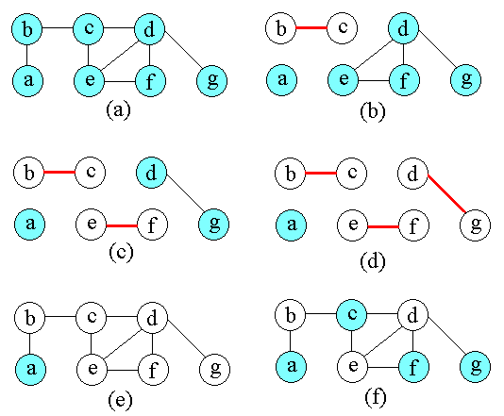
Examples of approximate algorithms ——vertex coverage
Figures (a) ~ (e) illustrate the running process and results of the algorithm. (e) represents the approximate optimal vertex cover Cset generated by the algorithm, which is composed of vertices b, c, d, e, f, and g.
(f) is a minimum vertex cover of graph G, which contains only 3 vertices: b, d and e.
The approximate ratio of the algorithm ApproxVertexCover is 2。（c=6，c*=3）

Slide 47
Examples of approximate algorithms ——vertex coverage
Theorem: The algorithm ApproxVertexCover is a 2 approximation algorithm.
proof：
Let A denote a set of edges selected by the algorithm ApproxVertexCover. Let C* denote the optimal vertex cover. Then C* must contain at least one endpoint of each side in A. Also, since no two edges in A share endpoints, no two edges in A are covered by the same vertex of C*.
Therefore, we have a lower bound on the scale of the optimal vertex cover: |C*|≥| A |.
On the other hand, the algorithm selects the two endpoints of each edge in A, with |C| = 2|A|
Therefore, | C | = 2 | A | ≤ 2 | C * |.

Slide 48
Ending

